Slide 1
IT694 Computer Networks
Week13_Lec2

Slide 2
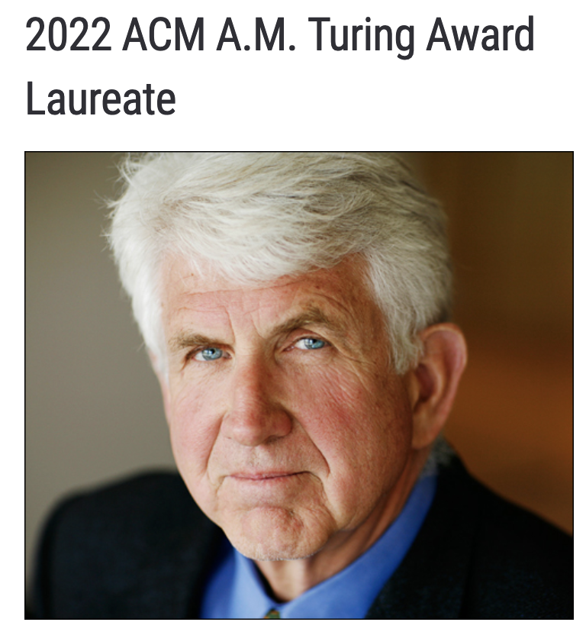
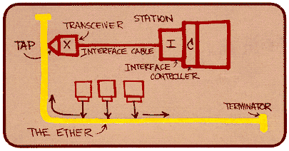
Ethernet
“dominant” wired LAN technology:
first widely used LAN technology
simpler, cheap
kept up with speed race: 10 Mbps – 400 Gbps
single chip, multiple speeds (e.g., Broadcom BCM5761)
Bob Metcalfe: Ethernet co-inventor,
2022 ACM Turing Award recipient
Metcalfe’s Ethernet sketch
https://www.uspto.gov/learning-and-resources/journeys-innovation/audio-stories/defying-doubters

Slide 3


Ethernet: physical topology
bus: popular through mid 90s
all nodes in same collision domain (can collide with each other)
switched: prevails today
active link-layer 2 switch in center
each “spoke” runs a (separate) Ethernet protocol (nodes do not collide with each other)
bus: coaxial cable
switched

Slide 4
Ethernet frame structure
sending interface encapsulates IP datagram (or other network layer protocol packet) in Ethernet frame
type
preamble
dest.
address
source
address
data (payload)
CRC
preamble:
used to synchronize receiver, sender clock rates
7 bytes of 10101010 followed by one byte of 10101011
type: indicates higher layer protocol
mostly IP but others possible, e.g., Novell IPX, AppleTalk
used to demultiplex up at receiver
addresses: 6 byte source, destination MAC addresses
if adapter receives frame with matching destination address, or with broadcast address (e.g., ARP packet), it passes data in frame to network layer protocol
otherwise, adapter discards frame
CRC: cyclic redundancy check at receiver
error detected: frame is dropped

Slide 5
IEEE 802.3 Ethernet standards: link & physical layers
many different Ethernet standards
common MAC protocol and frame format
different speeds: 2 Mbps, ... 100 Mbps, 1Gbps, 10 Gbps, 40 Gbps, 80 Gbps
different physical layer media: fiber, cable
application
transport
network
link
physical
MAC protocol
and frame format
1000BASE-T
1000BASE-SX
1000BASE-LX10
Gigabit PHY layer standards
1000BASE-CX
1000BASE-LX
1000BASE-BX10
copper (twister pair) physical layer
fiber physical layer

Slide 6
ARP: address resolution protocol
Question: how to determine interface’s MAC address, knowing its IP address?
ARP table: each IP node (host, router) on LAN has table
ARP
137.196.7.78
IP/MAC address mappings for some LAN nodes:
< IP address; MAC address; TTL>
TTL (Time To Live): time after which address mapping will be forgotten (typically 20 min)
1A-2F-BB-76-09-AD
ARP
ARP
LAN
71-65-F7-2B-08-53
58-23-D7-FA-20-B0
137.196.7.23
137.196.7.14
ARP
0C-C4-11-6F-E3-98
137.196.7.88

Slide 7
ARP protocol in action
example: A wants to send datagram to B
B’s MAC address not in A’s ARP table, so A uses ARP to find B’s MAC address
A broadcasts ARP query, containing B's IP addr
destination MAC address = FF-FF-FF-FF-FF-FF
all nodes on LAN receive ARP query
1
Ethernet frame (sent to FF-FF-FF-FF-FF-FF)
C
Source MAC: 71-65-F7-2B-08-53
Source IP: 137.196.7.23
Target IP address: 137.196.7.14
…
ARP table in A
IP addr
MAC addr
TTL
TTL
A
B
1
71-65-F7-2B-08-53
58-23-D7-FA-20-B0
137.196.7.23
137.196.7.14
D

Slide 8
ARP protocol in action
example: A wants to send datagram to B
B’s MAC address not in A’s ARP table, so A uses ARP to find B’s MAC address
ARP message into Ethernet frame (sent to 71-65-F7-2B-08-53)
C
Target IP address: 137.196.7.14
Target MAC address:
58-23-D7-FA-20-B0
…
ARP table in A
IP addr
MAC addr
TTL
TTL
A
B
2
71-65-F7-2B-08-53
58-23-D7-FA-20-B0
137.196.7.23
137.196.7.14
2
B replies to A with ARP response, giving its MAC address
D

Slide 9
ARP protocol in action
example: A wants to send datagram to B
B’s MAC address not in A’s ARP table, so A uses ARP to find B’s MAC address
C
ARP table in A
IP addr
MAC addr
TTL
TTL
A
B
137.196.
7.14
58-23-D7-FA-20-B0
500
71-65-F7-2B-08-53
58-23-D7-FA-20-B0
137.196.7.23
137.196.7.14
3
A receives B’s reply, adds B entry into its local ARP table
D

Slide 10
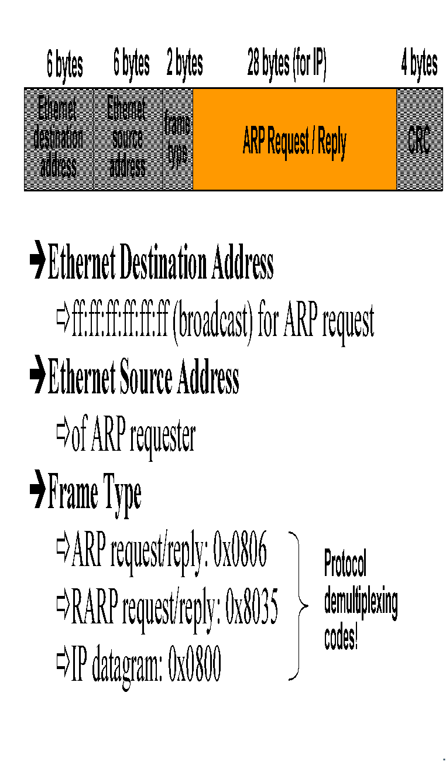

Slide 11
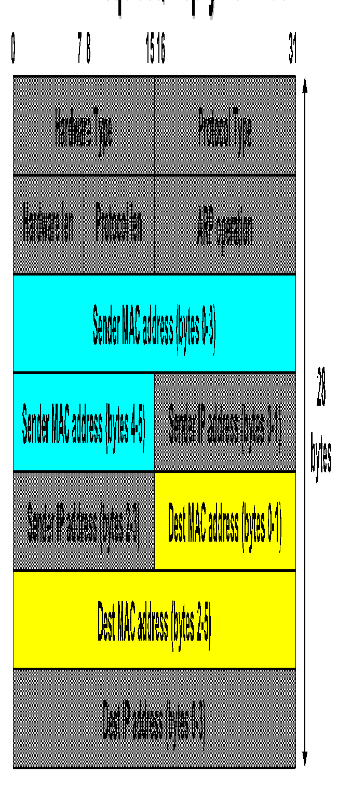


Slide 12
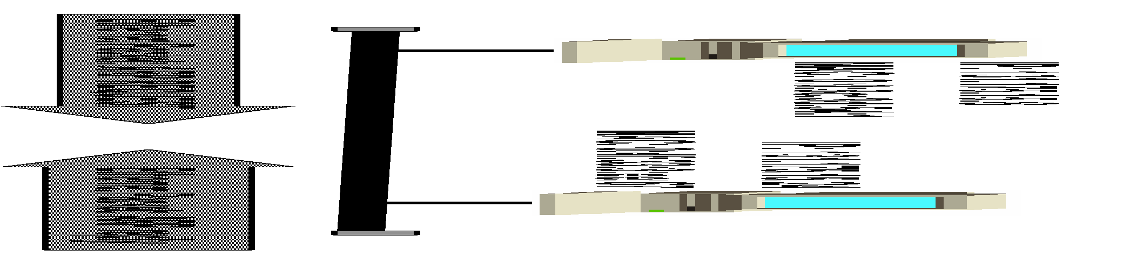
Dest MAC
SRC MAC
ARP frame type
Ethernet/IP
MAC=6/IP4/rq=1, rp=2
SRC MAC
DEST MAC
DEST IP
Checksum

Slide 13
Ethernet CSMA/CD algorithm
Why 512 bit times?
Ethernet receives datagram from network layer, creates frame
If Ethernet senses channel:
if idle: start frame transmission.
if busy: wait until channel idle, then transmit
If entire frame transmitted without collision - done!
If another transmission detected while sending: abort, send jam signal
After aborting, enter binary (exponential) backoff:
after mth collision, chooses K at random from {0,1,2, …, 2^{m}-1}. Ethernet waits K·512 bit times, returns to Step 2
more collisions: longer backoff interval
Notes:
For Ethernet, the actual amount of time a node waits is K # 512 bit times (i.e., K times the amount of time needed to send 512 bits into the Ethernet) and the maxi- mum value that n can take is capped at 10.

